Slide 1

Bootstrap v4.0.0
MARCO RUBIO

Slide 2
Contents
What is Bootstrap?
The GRID
The GRID Examples
Components
Utilities
General Guidelines
How to install
Homework
Contact Information
Additional Resources

Slide 3



What is Bootstrap?
Most popular CSS/JavaScript framework for creating responsive and mobile – first sites.
Open – source.
Out-of-the-box tools and components for building your site.
12 column grid-based system for responsiveness.
Uses Flex Box instead of percentages.
Other CSS frameworks:

Slide 4






What is Bootstrap?
Sites that use Bootstrap
And thousands more…

Slide 5
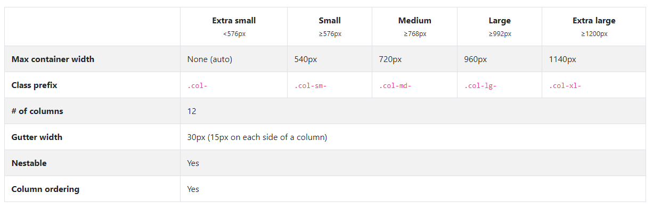
The GRID
Enables you to create the layout of your site easily and be responsive.
12 columns.
5 Breakpoints

Slide 6
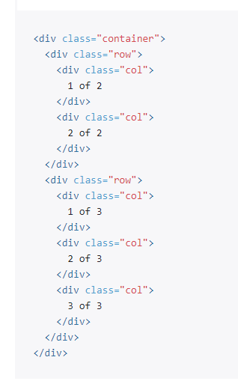
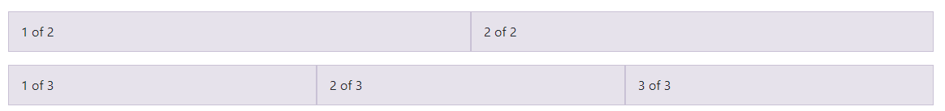
The GRID Examples
Containers: Most basic layout element and is required.
Container – Fluid: Full width of the container.
Rows: Wrappers for columns.

Slide 7
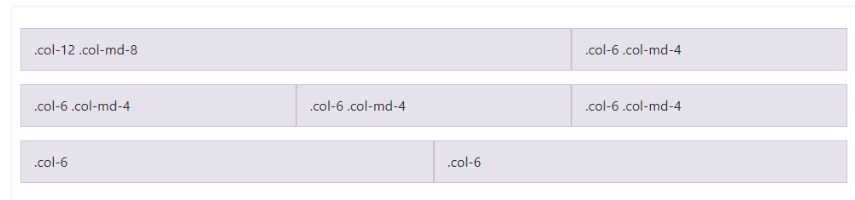
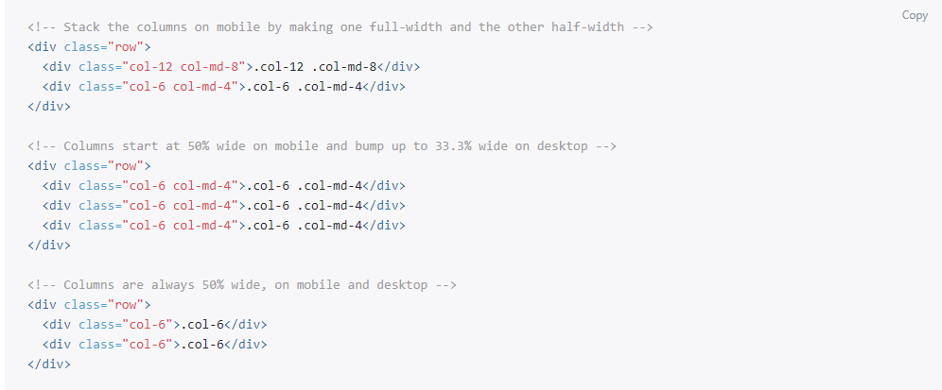
The GRID Examples
Live Example

Slide 8
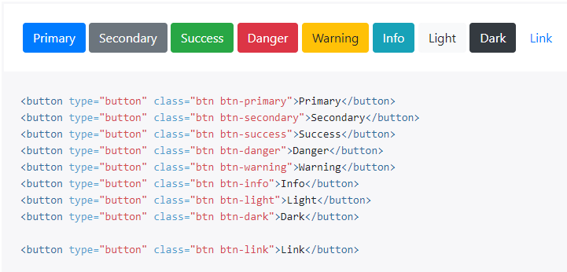
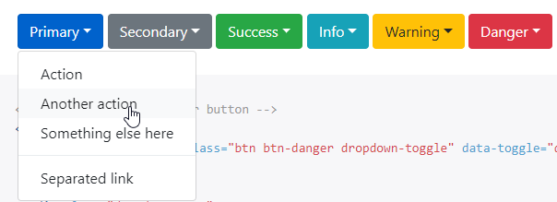
Components
Buttons
Dropdowns (Live Example)

Slide 9
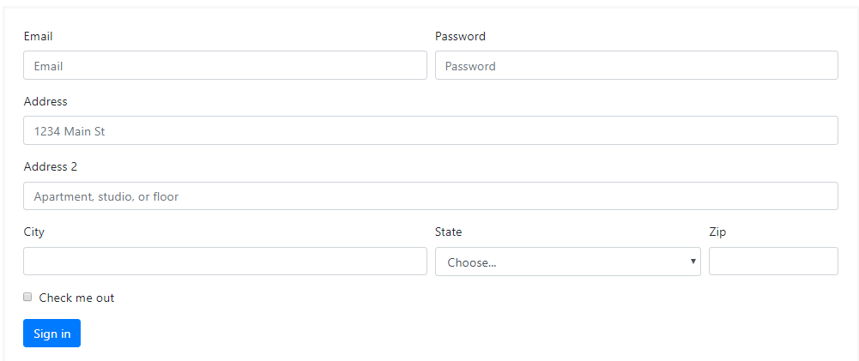
Components
Collapse
Live Example
Forms
Live Example

Slide 10
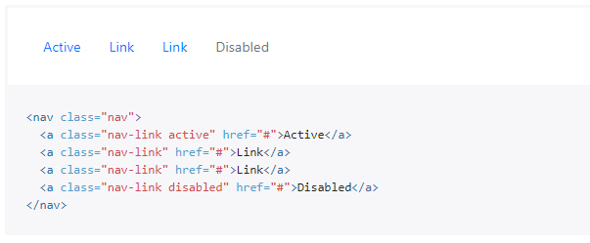
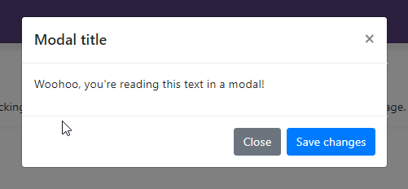
Components
Modal
Live Example
Navs (Live Example)

Slide 11
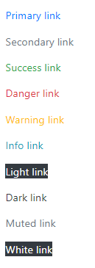
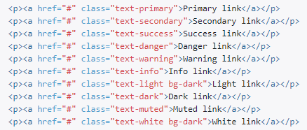
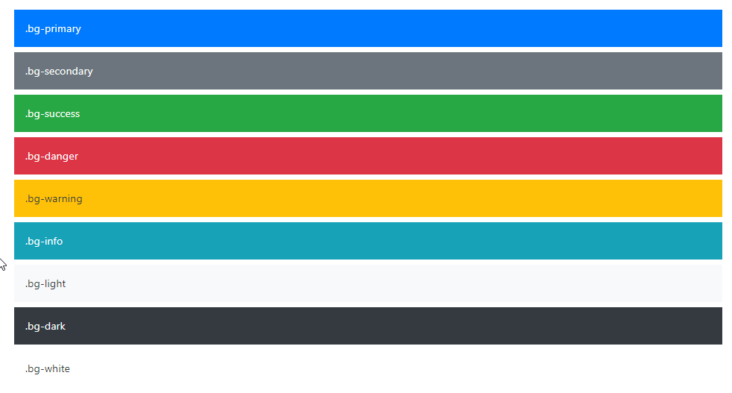
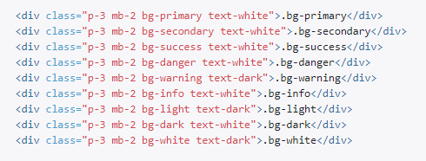
Utilities
Text colors
Background colors

Slide 12
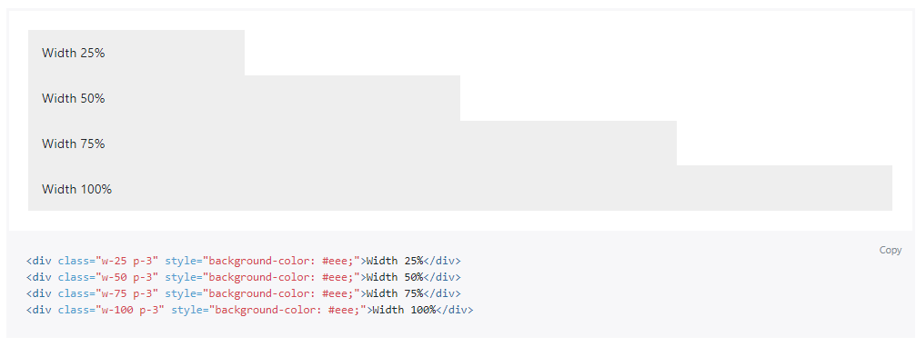
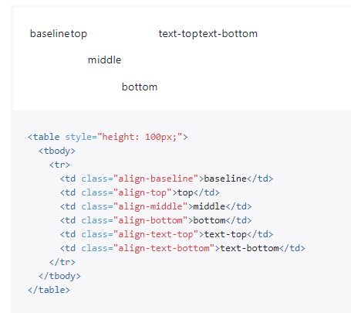
Utilities
Sizing
Vertical Alignment

Slide 13
Utilities
Hidding Elements
Live Example

Slide 14
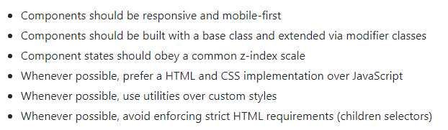
General Guidelines for extending and customizing.

Slide 15
How to install
Show demo.

Slide 16
Homework
Create a personal website with the following requirements:
Use Bootstrap v.4.0.0 Grid System
Have 4+ different sections
Use 5+ components
Fully responsive
Extra points for creativity and using more sections/components.
Due Date: August 7th 2018 before 5PM.
When finished, send project in a .ZIP file to my email.
Feel free to ask me if you have any questions/doubts.

Slide 17
Additional Resources
Bootstrap: https://getbootstrap.com/
Bootstrap Components: https://getbootstrap.com/docs/4.0/components/
Bootstrap Grid: https://getbootstrap.com/docs/4.0/layout/grid/
Bootstrap Expo: http://expo.getbootstrap.com
Bootstrap Examples: https://getbootstrap.com/docs/4.0/examples/
Awwwards: https://www.awwwards.com/websites/bootstrap/
Bootstrap Classes Cheatsheet: https://hackerthemes.com/bootstrap-cheatsheet/

Slide 18
Contact Information
Email: marubio@sciodev.com
Skype: m.rubio01
THANK YOU!

